Slide 1
A SURVEILLANCE SYSTEM FOR AIR POLLUTION MONITORING – WARNING AND MANAGEMENT
SMART INDIA HACKATHON-2018
MINISTRY: Government Of Tamil Nadu
PROBLEM CODE:#GTN2
COLLEGE CODE :3668
TEAM : PAVAN
TEAM LEADER: FAHEEN FATHIMA B.N

Slide 2
PROPOSED SYSTEM
Introduction of “PAVAN” <air pollution detector> such that the complete area is monitored for major air pollutants found in the atmosphere.
SPECIALITIES OF PAVAN:
Senses major air pollutants
Differentiates the air pollutants
Indicates the amount of pollution
Management of statistical data
Provides user friendly approach to access and maintain the data

Slide 3
MAJOR COMPONENTS
Arduino uno
Shinyei PPD42 [particulate matter]
MiCS-2714 [NO2]
MiSC-2614 [OZONE]
MQ-2
MQ-9
Keyes DHT11 [TEMPERATURE AND HUMIDITY]

Slide 4
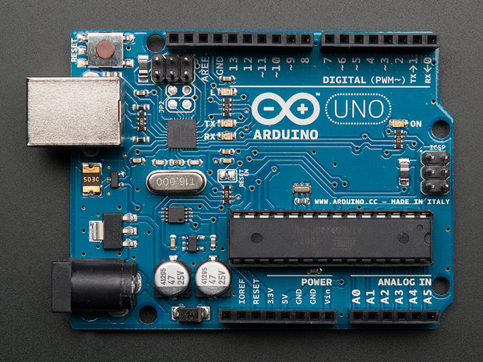
ARDUINO UNO

Slide 5
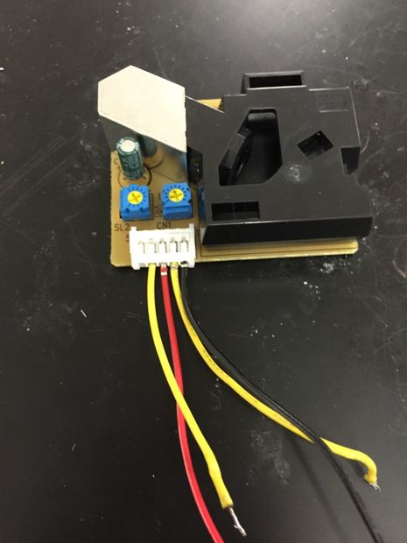
Shinyei ppd42

Slide 6
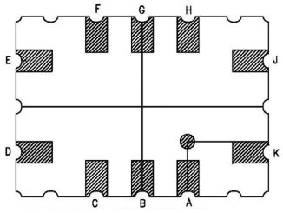
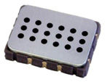
mIcs- 2714 [NO2] MISC- 2614 [OZONE]

Slide 7
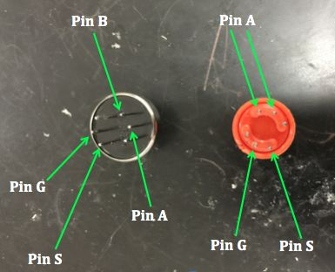
MQ-2 MQ-9

Slide 8
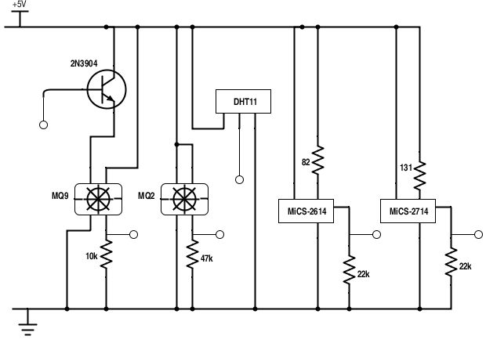
GAS SENSOR CIRCUIT BOARD

Slide 9
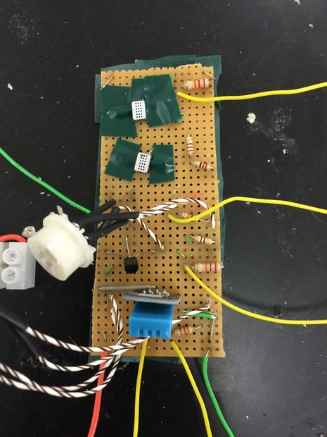
EXTERNAL CIRCUITARY

Slide 10
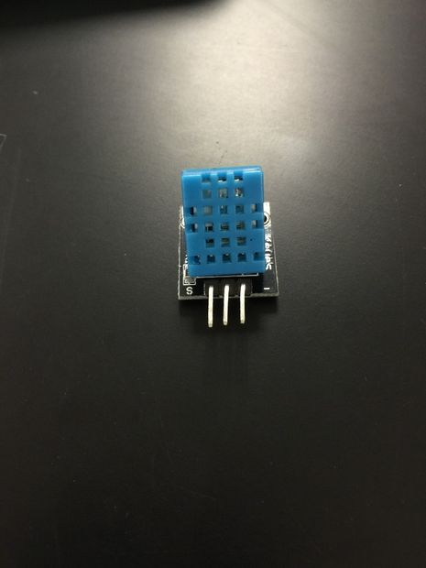
TEMPERATURE AND HUMIDITY KEYES DHT11

Slide 11
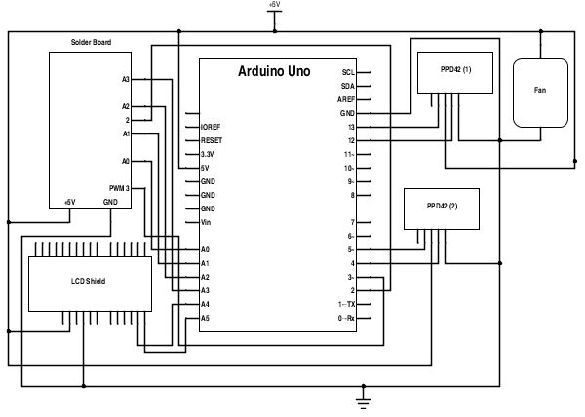
OVERALL CIRCUIT DIAGRAM

Slide 12

USER INTERFACE

Slide 13
THANK YOU!

